Slide 1
Alternatives to Traditional Endoscopy
Overview for Primary Care

Slide 2
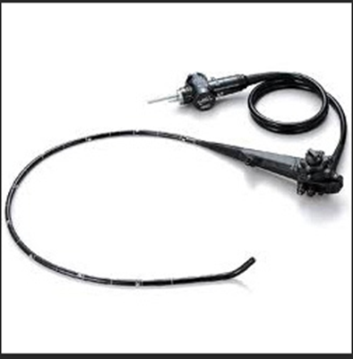
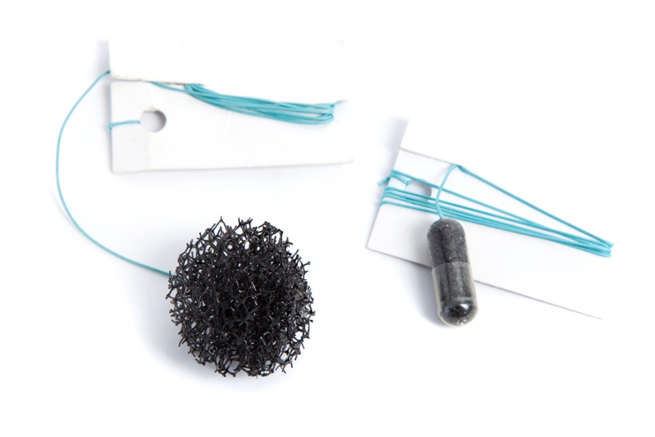
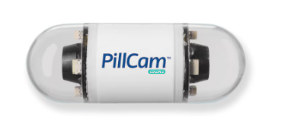
Alternatives to Traditional Endoscopy
Trans-nasal Endoscopy
Capsule Sponge
Capsule Endoscopy

Slide 3
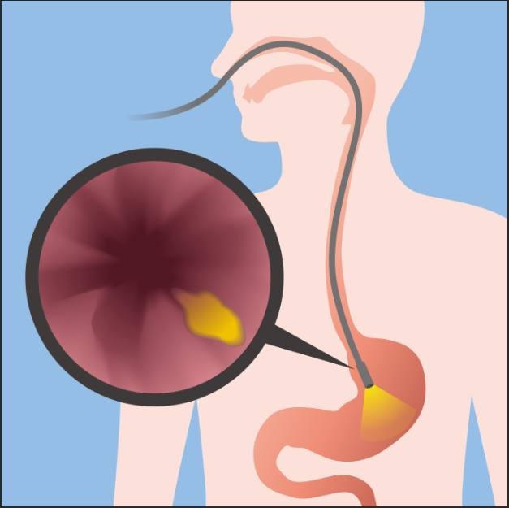
Transnasal Endoscopy TNE
Method of Upper GI endoscopy via nasal route
Ultra thin endoscope 6mm
Typically performed with patient sitting in upright position
Image from Transnasal Esophagoscopy - Alamo ENT Associates

Slide 4
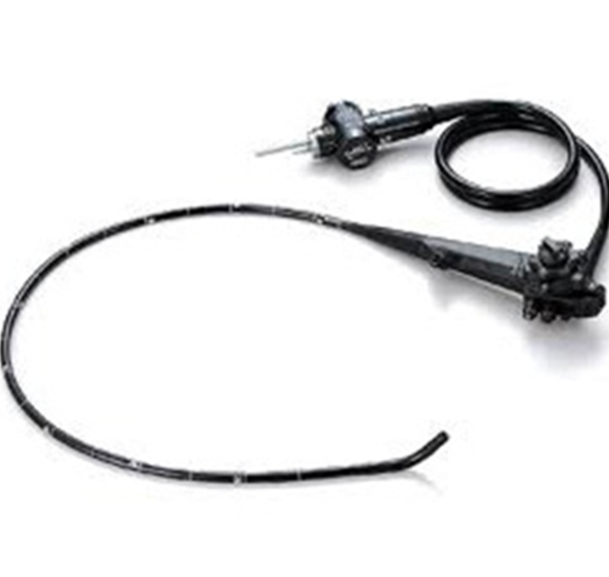
Contraindications to TNE
Base of skull fracture/facial surgery
Trauma to nasal cavity – surgery/injury
Major/life threatening epistaxis (within 6 weeks)
Hereditary haemorrhagic telangiectasis (HHT)
Severe movement disorder
Agitation
Vasovagal history

Slide 5
Benefits and Risks
Risks/limitations of TNE
Benefits of TNE
Better tolerated
Reduced cardiovascular stress
No need for sedation
Quicker throughput of patients
Immediate recovery
Mobile stacker unit
ENT pathology
Unsuitable for some patients
4% risk of epistaxis
Risk of nasal pain/discomfort
Potential failure of TNE
Smaller biopsy forceps
Clearing of bubbles and mucous – timely
Image quality

Slide 6
Capsule sponge
In C&M Capsule sponge device is used for investigations of symptoms of uncomplicated GORD, and in surveillance of patients with known Barrett’s oesophagus
Small tethered capsule is swallowed
This dissolves in the stomach to provide a mildly abrasive sponge
During retrieval this collects cells from stomach and oesophagus
Cytological assessment is performed through microscopy and immunohistochemical investigation.
Looking for:
Trefoil Factor 3 (TFF3), a molecular biomarker for intestinal metaplasia,
P53, a biomarker used to identify cellular atypia.
Aims to provide an alternative first line investigation method for patients with gastroesophageal reflux disease (GORD)

Slide 7
Capsule Sponge
Indications include:
Heartburn
Regurgitation
Waterbrash
For Barrett’s surveillance patients' additional requirements include:
One endoscopic surveillance completed since initial diagnosis of Barrett’s
Adequate biopsies taken as per BSG guidelines

Slide 8
Capsule sponge
Cytology Outcomes
Cell metaplasia
may indicate the presence of Barrett’s oesophagus.
This would indicate routine endoscopy
Cellular atypia
may indicate dysplastic changes requiring urgent gastroscopy.
No indication of cell changes
may not require endoscopy.
Benefits
Risks
Use as a triaging tool can identify those who truly warrant endoscopy assessment and those who can be medically managed in the community
Can help met the challenge of identifying those who would most benefit from endoscopy
Can be performed outside of the endoscopy unit by non-specialised clinical staff
Mild sore throat reported
Small risk of sponge detachment - <1/1000 which may then require endoscopy
Bleeding

Slide 9
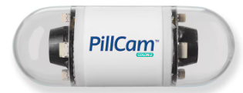
COLON Capsule Endoscopy (CCE)
Capsule the size of a large vitamin containing 2 cameras.
Does not require radiation, sedation or admission
Non-invasive so can be better tolerated than other modalities
NHS Clinical Guidance permits use of CCE in patients on urgent suspected cancer pathways:
Those with a FIT 10-100ug/gm or
Those with a FIT <10 with concerning symptoms

Slide 10
Considerations for CCE:
Capsule retention:
Rare <2%
Defined as presence of capsule in digestive tract for minimum of 2 weeks
Confirmed by X-ray.
Majority of cases are asymptomatic and managed conservatively
Bowel preparation is still required to obtain images
If pathology identified may still need optical endoscopy
May not be suitable for some patients, mainly due to increased risk of incomplete procedure or inadequate bowel prep such as:
Dysphagia,
Crohn’s disease
Strictures
Long term daily use of NSAIDs
Abdominopelvic irradiation

Slide 11
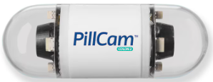
Summary
All in use for C&M Patients in Hubs
TNE
Capsule sponge
COLON capsule endoscopy
Upper GI endoscopy via nose
Can be better tolerated then oral route and unsedated
Can increase capacity
Not suitable for all, especially if facial injuries/conditions, bleeding disorders or issues with sitting upright/tolerating unsedated procedure.
Smaller scope size means smaller biopsy forceps
Swallowed ‘sponge on a string’ retrieved and then cytology
Used as first line to identify if endoscopy indicated – and urgency if so.
Also used for Barrett’s surveillance patients in some circumstances
Can take place outside of specialist endoscopy settings
Low risk if sponge detaches
Lower GI imaging
Can provide effective imaging with minimal risks
No sedation or radiation
Main risk is of capsule retention causing obstruction but low risk of this. Most cases of retention asymptomatic and managed conservatively

